Slide 1
Face Mask Detection
CVDL 2022
Nistor Robert

Slide 2
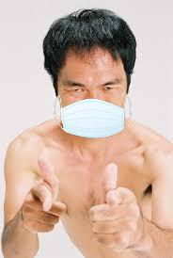
Motivation, Context & Objectives
With the COVID-19 pandemic, face masks have become an important tool for preventing the spread of the virus. A face mask detection algorithm could be used to help enforce mask-wearing rules in public spaces, and thus help to keep people safe.
A face mask detection algorithm could be used to automate the process of checking for mask-wearing in places where it is required, such as in stores, offices, or public transportation. This could save time and effort for both employees and customers.

Slide 3
Thank You !
Face Mask Detection
CVDL 2022 –
Nistor Robert

